Slide 1
Computer Vision Rubik’s Cube Solver
Daniela Tomás up202004946@edu.fc.up.pt
Diogo Nunes up202007895@edu.fc.up.pt

Slide 2
Introduction
We developed a Rubik’s cube solver that uses computer vision techniques to detect and analyze the colors on each face of the cube and then generate a sequence of moves to solve it. This presentation will provide an overview of the algorithms and processes used and discuss the results achieved.
Libraries used:
OpenCV: Well-known open-source computer vision library for processing images and videos. We used it for various image processing operations, including contour and edge detection, color range filtering, and rectangle drawing.
NumPy: Python library used for numerical operations. It was used for handling arrays and matrices.
Kociemba: Library for solving Rubik’s cubes. Given the cube's state, it can provide a sequence of movements to solve the puzzle.

Slide 3
White Balancing
A

Slide 4
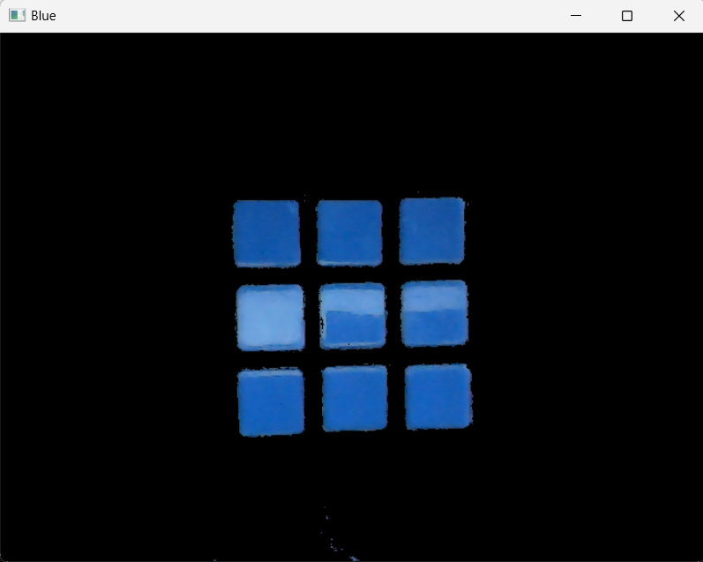
Color Detection
Blue
Green
White
Orange
Red
Yellow
(100-130, 100-255, 100-255)
(0-179, 0-50, 120-255)
(160-180, 100-255, 100-255)
Each Rubik’s cube color has a color range in the HSV format (Fig.1), which the program uses to isolate the regions in the frame that most likely contain Rubik's cube stickers of the desired color and produce a mask for each color.
To improve the accuracy of color detection, additional image processing techniques were applied to the mask, such as Gaussian blur, morphological operations, and edge detection.
(30-99, 100-255, 100-255)
(5-20, 100-255, 100-255)
(21-35, 100-255, 100-255)
Fig.1 - Set of HSV of color ranges used for each of the six colors on the Rubik’s cube.
Note: In Fig.1, the ranges represent the acceptable color values for detecting each face in an environment controlled by us. The values may vary due to different lighting conditions.
Fig.2 – Blue mask.

Slide 5
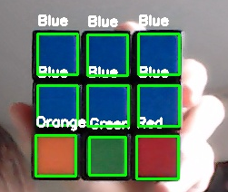
Square Detection
(289, 103)
(344, 104)
To be considered a square and distinguish Rubik’s cube stickers from other objects in the frame, a contour must satisfy the following conditions:
The contour must have four vertices;
The aspect ratio is close to 1;
Contours with areas that fall within a specific range are considered.
If a square is detected, the program draws a bounding rectangle around it and annotates it with the color's name in real time.
If 9 squares are detected in a frame (Fig.3), they are sorted by their y-coordinates, grouped into sets of three (representing a row of the Rubik’s cube), and then sorted by their x-coordinates to create a face.
(400, 103)
(289, 160)
(400, 160)
(344, 160)
(287, 215)
(346, 217)
(398, 216)
Fig.3 – Nine squares detected in a single frame.

Slide 6
Kociemba Algorithm
When all the 6 faces are detected, the program generate a Kociemba string representing the color configuration of the entire Rubik’s cube.
Solved Rubik’s cube string:
“UUUUUUUUURRRRRRRRRFFFFFFFFFDDDDDDDDDLLLLLLLLLBBBBBBBBB“
Example:
>> kociemba.solve('DRLUUBFBRBLURRLRUBLRDDFDLFUFUFFDBRDUBRUFLLFDDBFLUBLRBD’)
u"D2 R' D' F2 B D R2 D2 R' F2 D' F2 U' B2 L2 U2 D R2 U"
D
U
U
R
U
U
F
U
L
L
U
U
U
L
B
B
U
F
U
U
R
R
R
L
F
U
R
D
D
B
L
F
F
R
R
F
R
F
R
B
L
D
R
B
F
F
R
R
F
U
F
R
U
R
F
R
D

Slide 7
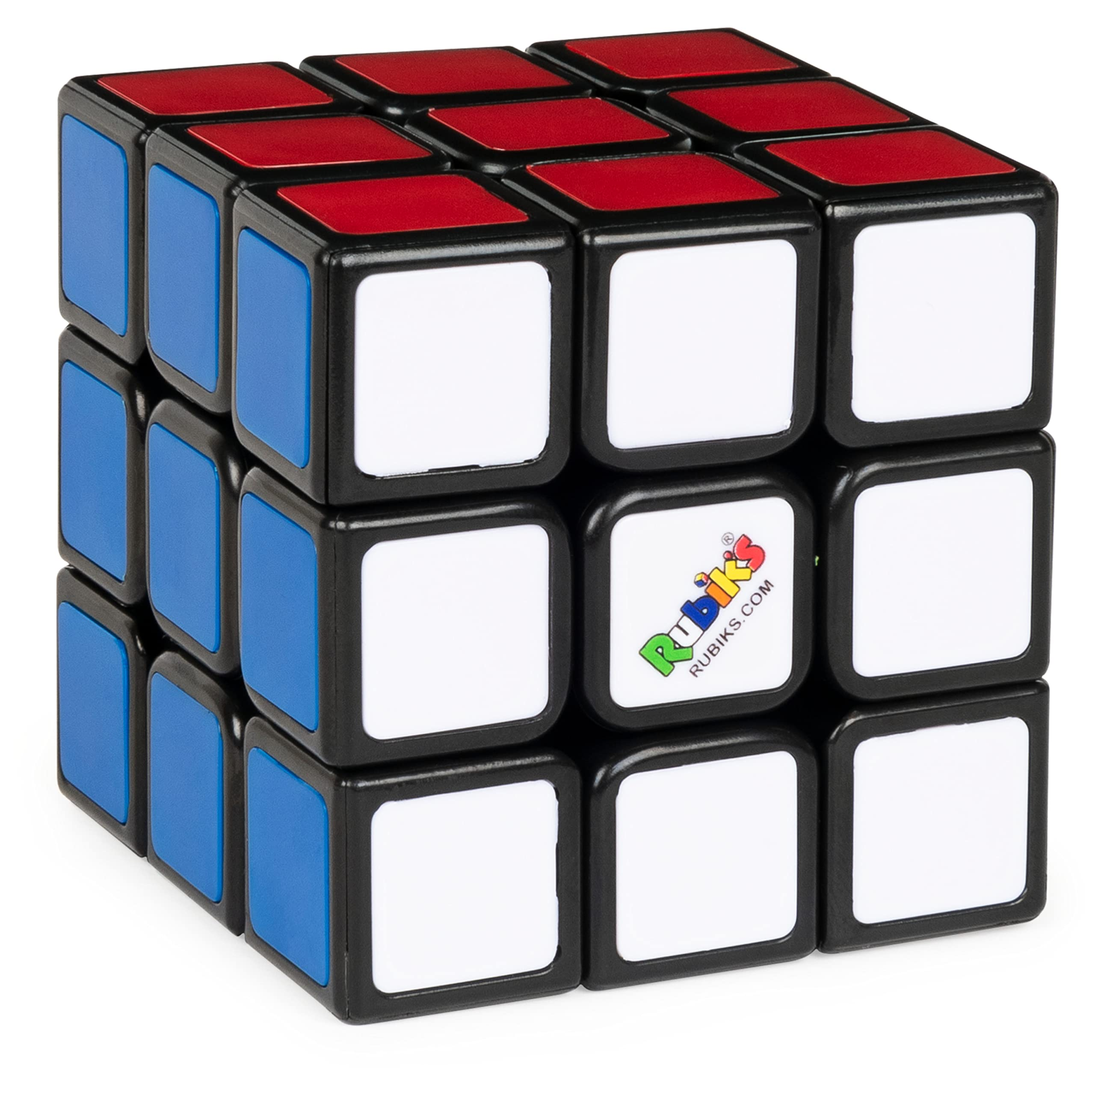
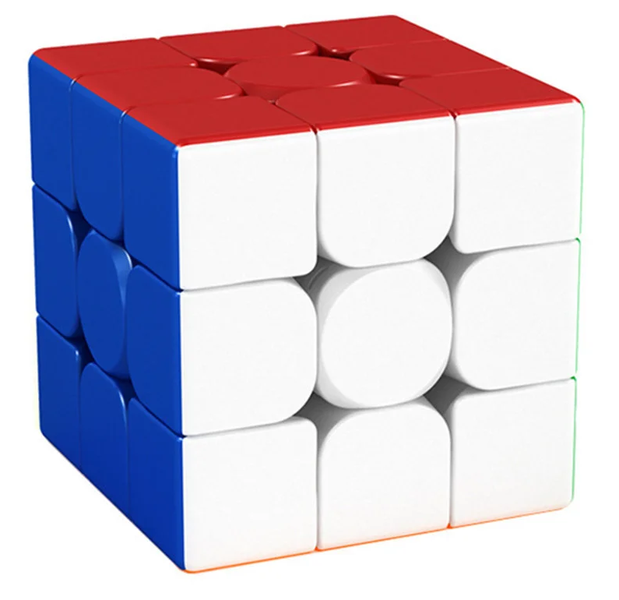
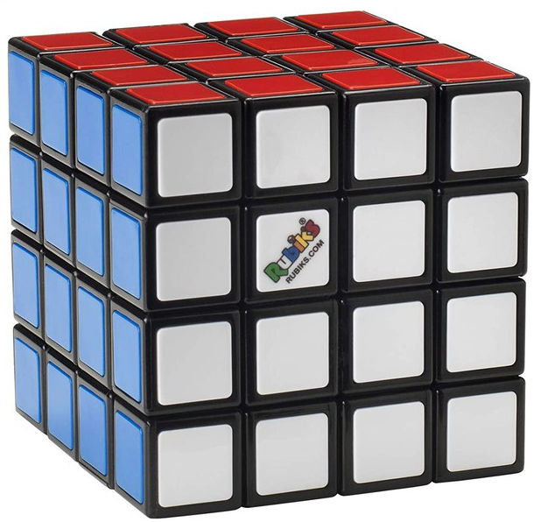
Conclusion
The computer's vision Rubik’s cube solver has been implemented successfully.
Future work could include improving the detection of cubes other than Rubik’s brand and even extending our system to solve larger cubes. We could also use techniques for 3D reconstruction and automatic color range adjustment to improve adaptability to different lighting environments. Another point for improvement would be the user interface for a more intuitive experience.

